Slide 1


Slide 2


Slide 3
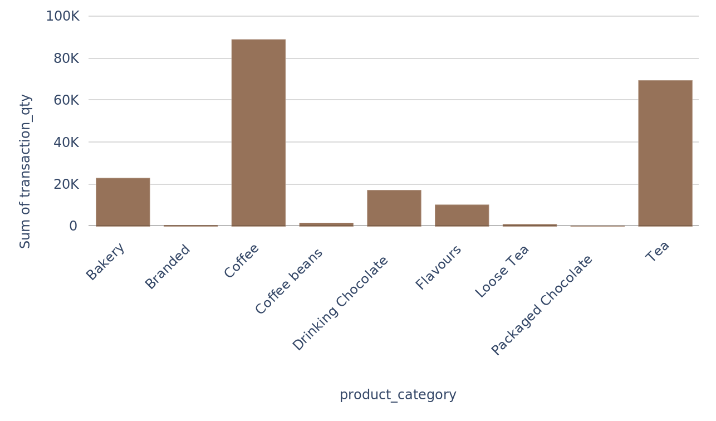
Transaction_qty per product_category
2

Slide 7
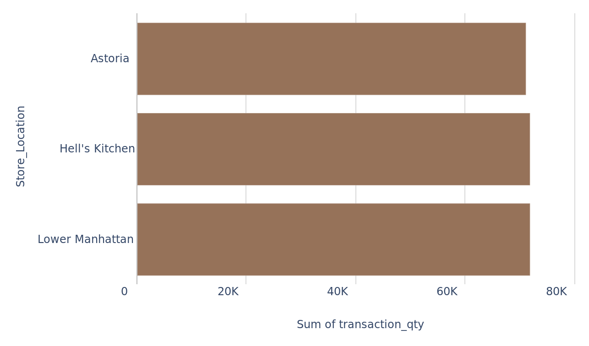
Transaction_qty per store_location
4

Slide 9
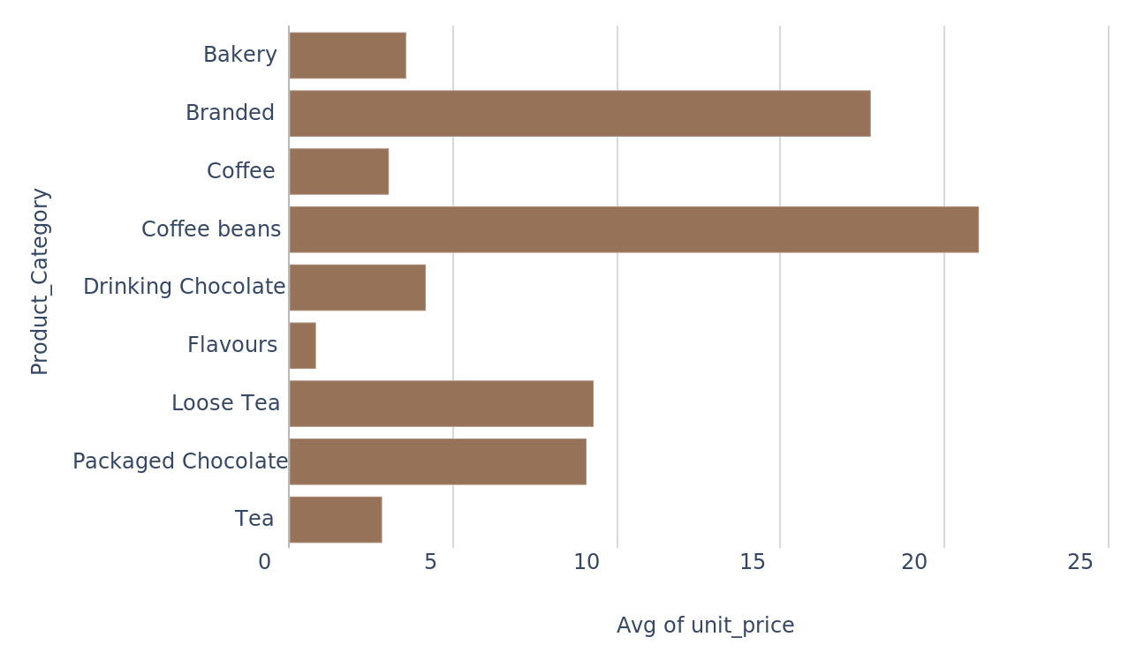
Unit_price per product_category
5

Slide 10
6

Slide 11
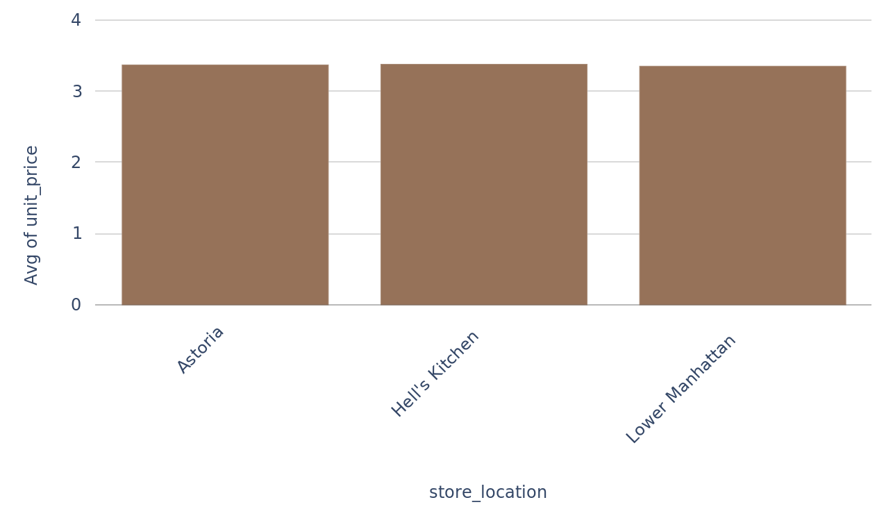
Unit_price per store_location
7

Slide 12
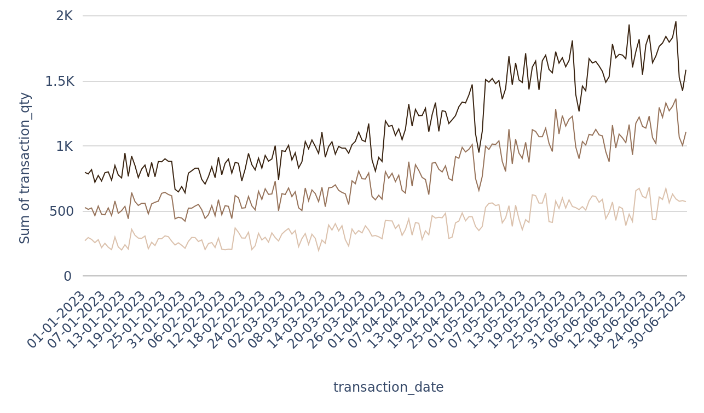
Transaction_qty per transaction_date, grouped by store_id
8

Slide 14
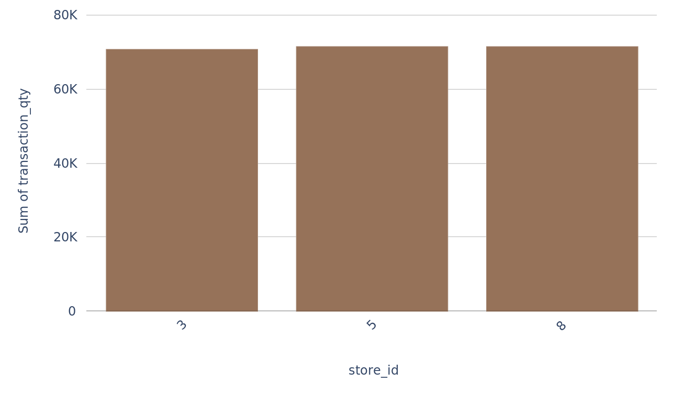
Transaction_qty per store_id
9

Slide 15
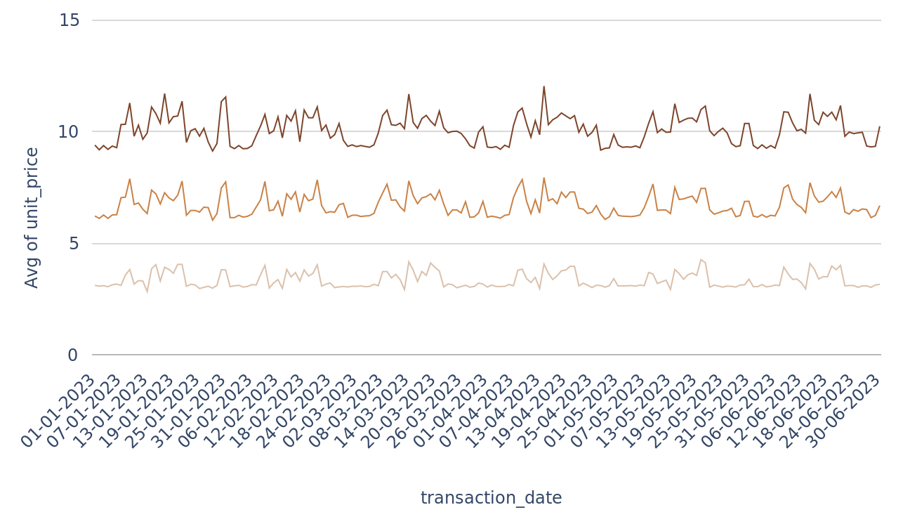
Unit_price per transaction_date, grouped by store_id
10

Slide 16
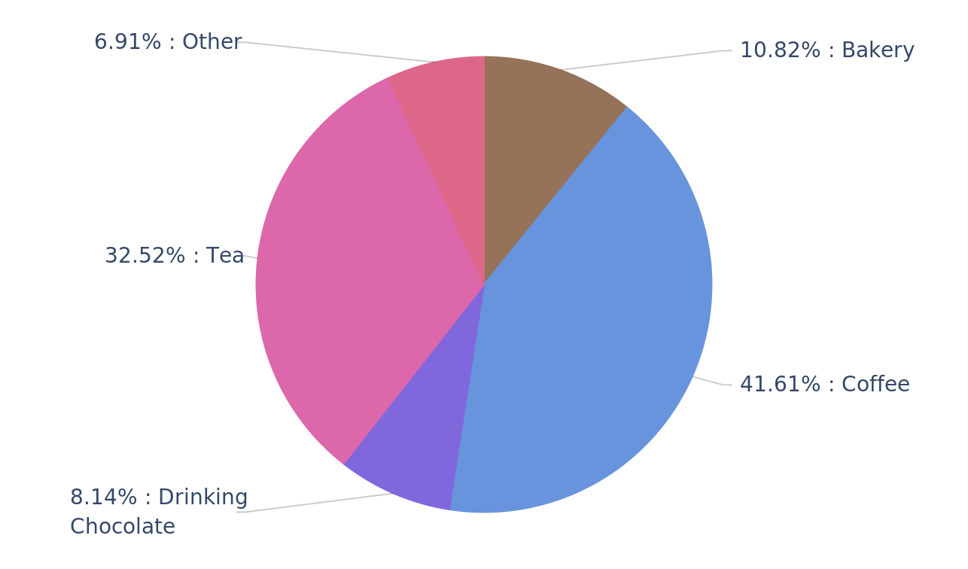
Transaction_qty per product_category
11

Slide 17
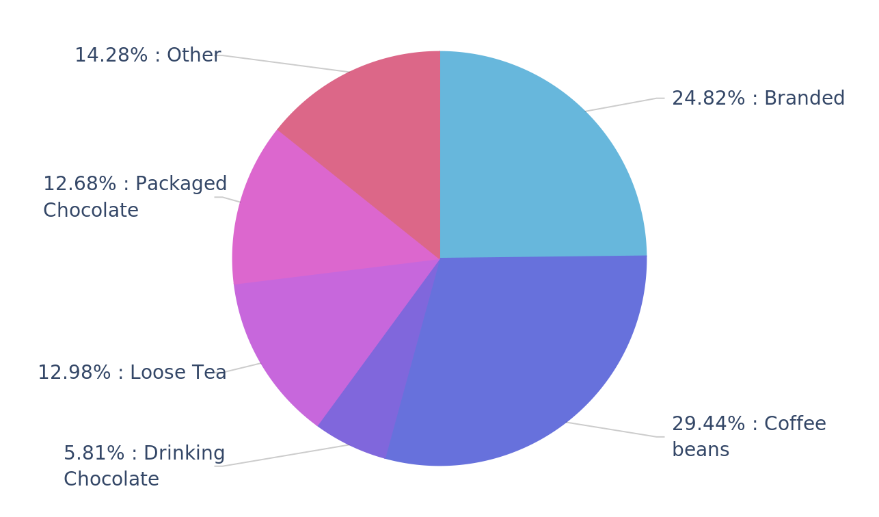
Unit_price per product_category
12

Slide 18
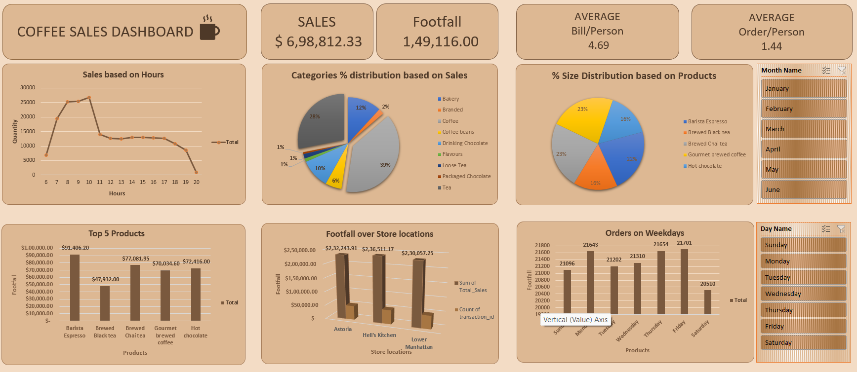

Slide 19


